Slide 1
DEBOCK INDUSTRIES LIMITED

Slide 2
DEBOCK started operations in year 2008 as a private limited company and got public in the year 2017. Company is lead from the front by Mr. Mukesh Manveer Singh, a visionary leader who is very clear in his taught and plan about how company will continue rising very successive day .
Debock is one of the few companies in market who is having a successful track in business irrespective to diversified business lines.
INTRODUCTION

Slide 3
Debock is brainchild of
Mukesh Manveer a visionary businessman comes from a small town in Rajasthan, Deoli. Having a hands-on experience of Marble business, understands the business domain of rural India from core.
Established business in the field of Hospitality, Agriculture equipment's and many more.
Leading the team from front have a vast experience of Real estate and a rich experience of working with multiple big names in country facilitates him to leverage the relations in other business lines.

Slide 4
Authorized Capital: 90 Crore
Subscribed Capital : 38.22 crore
Paid Up capital : 38.22 crore
Number of subscribers : 744
Face Value: 10
Market Value as on date:
Market Cap as on date : 34133 Lacs

Slide 5
Hospitality: Hotel Debock In
Agriculture equipment's Manufacturing
Sales and Marketing
Business Lines:

Slide 6
Expansion Plans

Slide 7
Hospitality
Hospitality and Hotel Industry is booming sector in Rajasthan. We have signed an MOU with Rajasthan Government to develop a Chain of Resorts in Rajasthan for premium tourists visiting Rajasthan. We have already taken first step by started construction of our first unit in Chakshu, labana, Shivdaspura in acres of land.
We have also started construction of new Food courts on highways of Rajasthan, first unit up and running in Deoli. we will also provide charging stations at all our food courts
There are plans to acquire small units in virgin tourist places of Rajasthan to give a pleasant and comfortable stay to the tourists visiting our state. After writing a success story here in Rajasthan we will duplicate the idea in other virgin destinations of rest of India. We have planned for virgin destinations because big players are not focusing this market.
We will Also on the path of creating a Mobile application to bring all these destination under single platform and providing customized tour plans for Tourist.

Slide 8
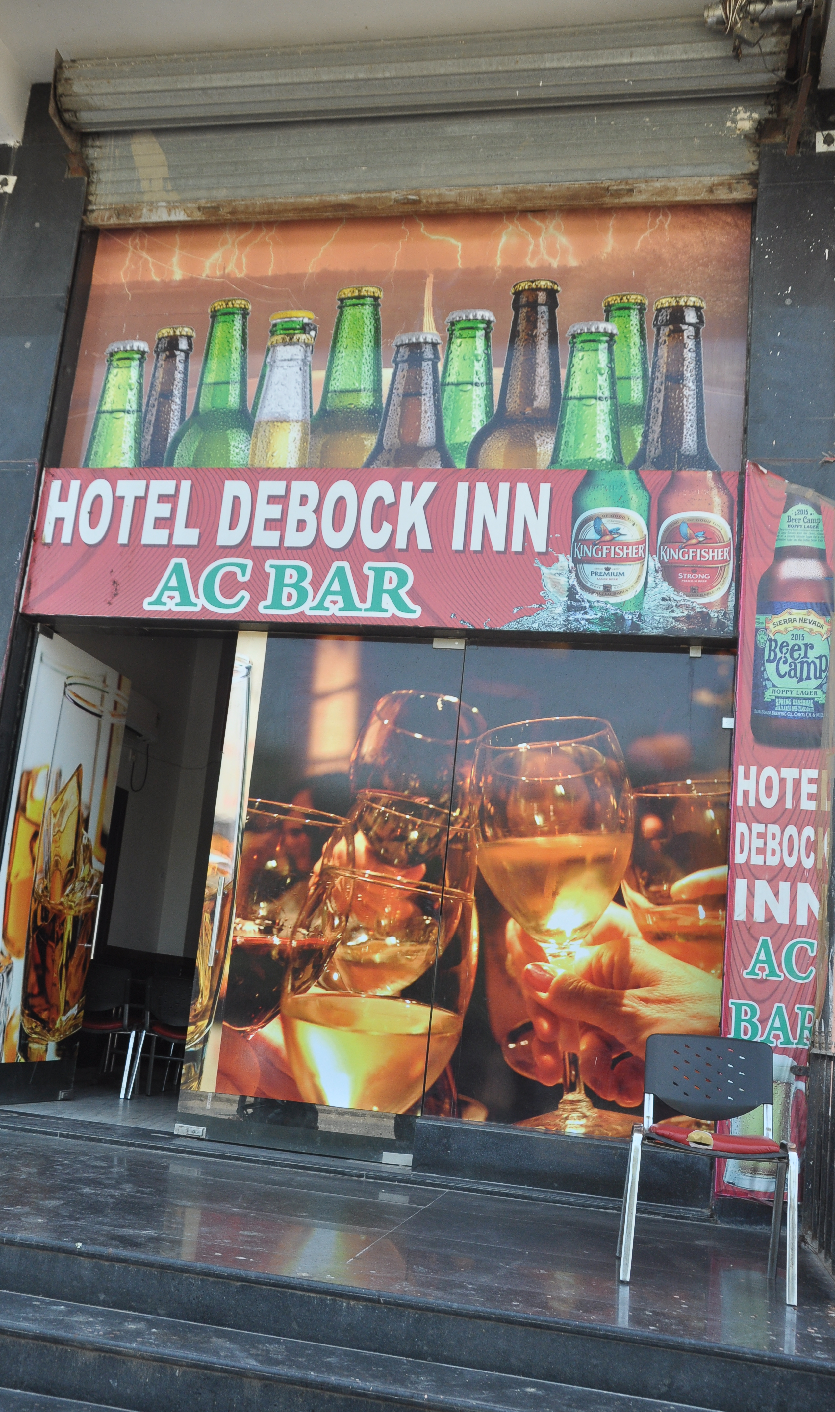
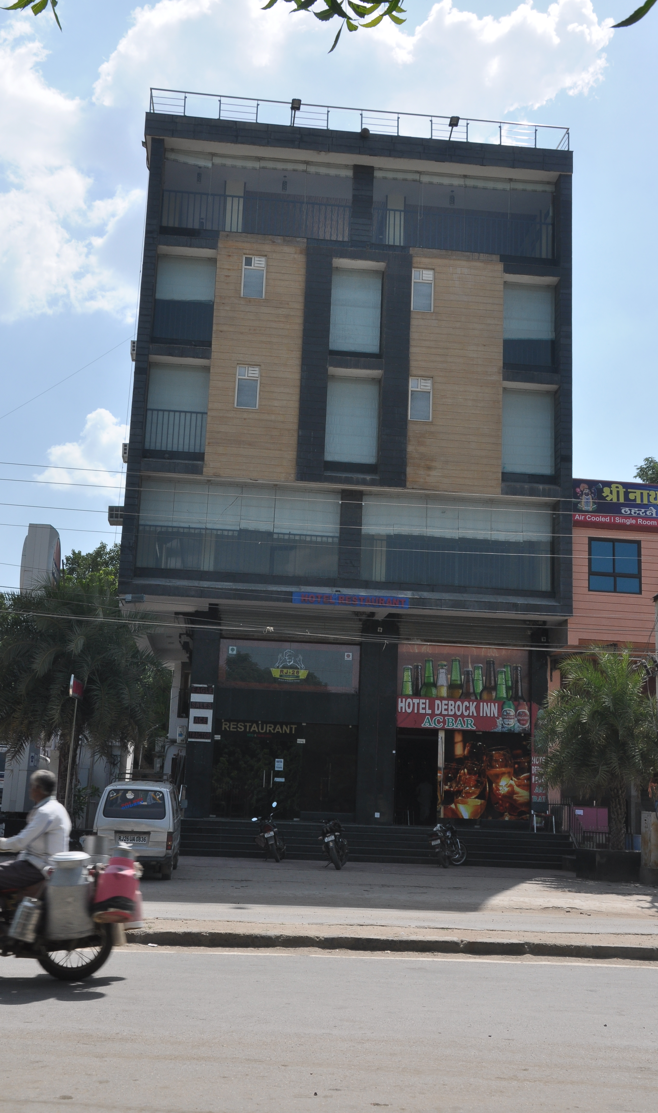
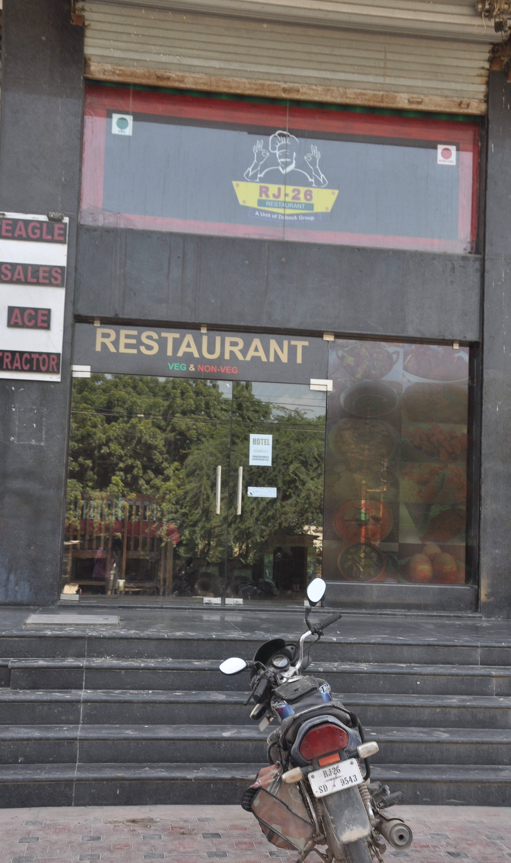

Slide 9
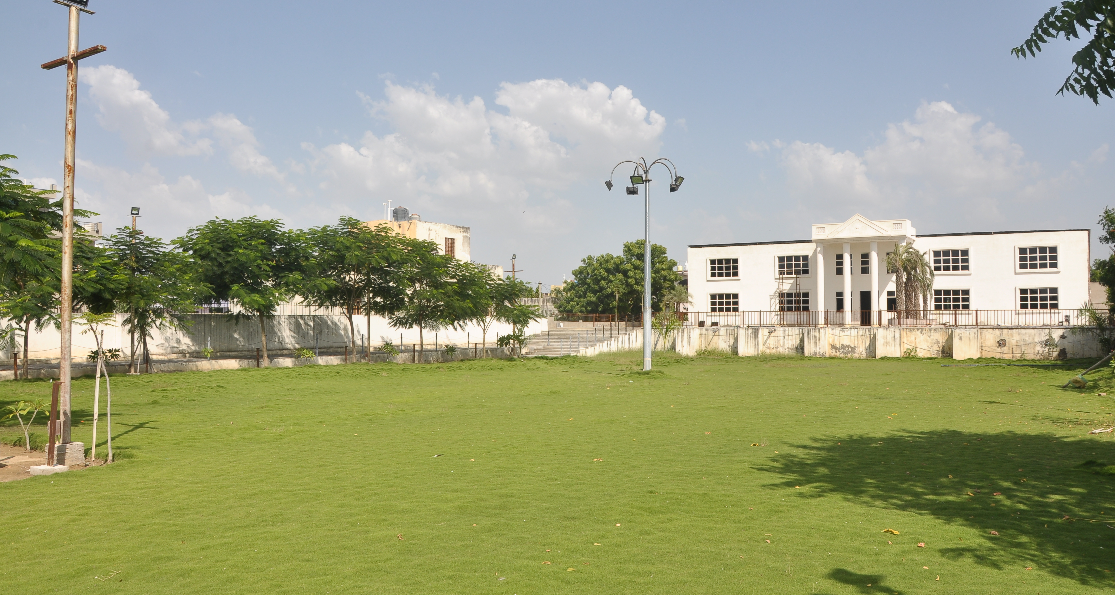
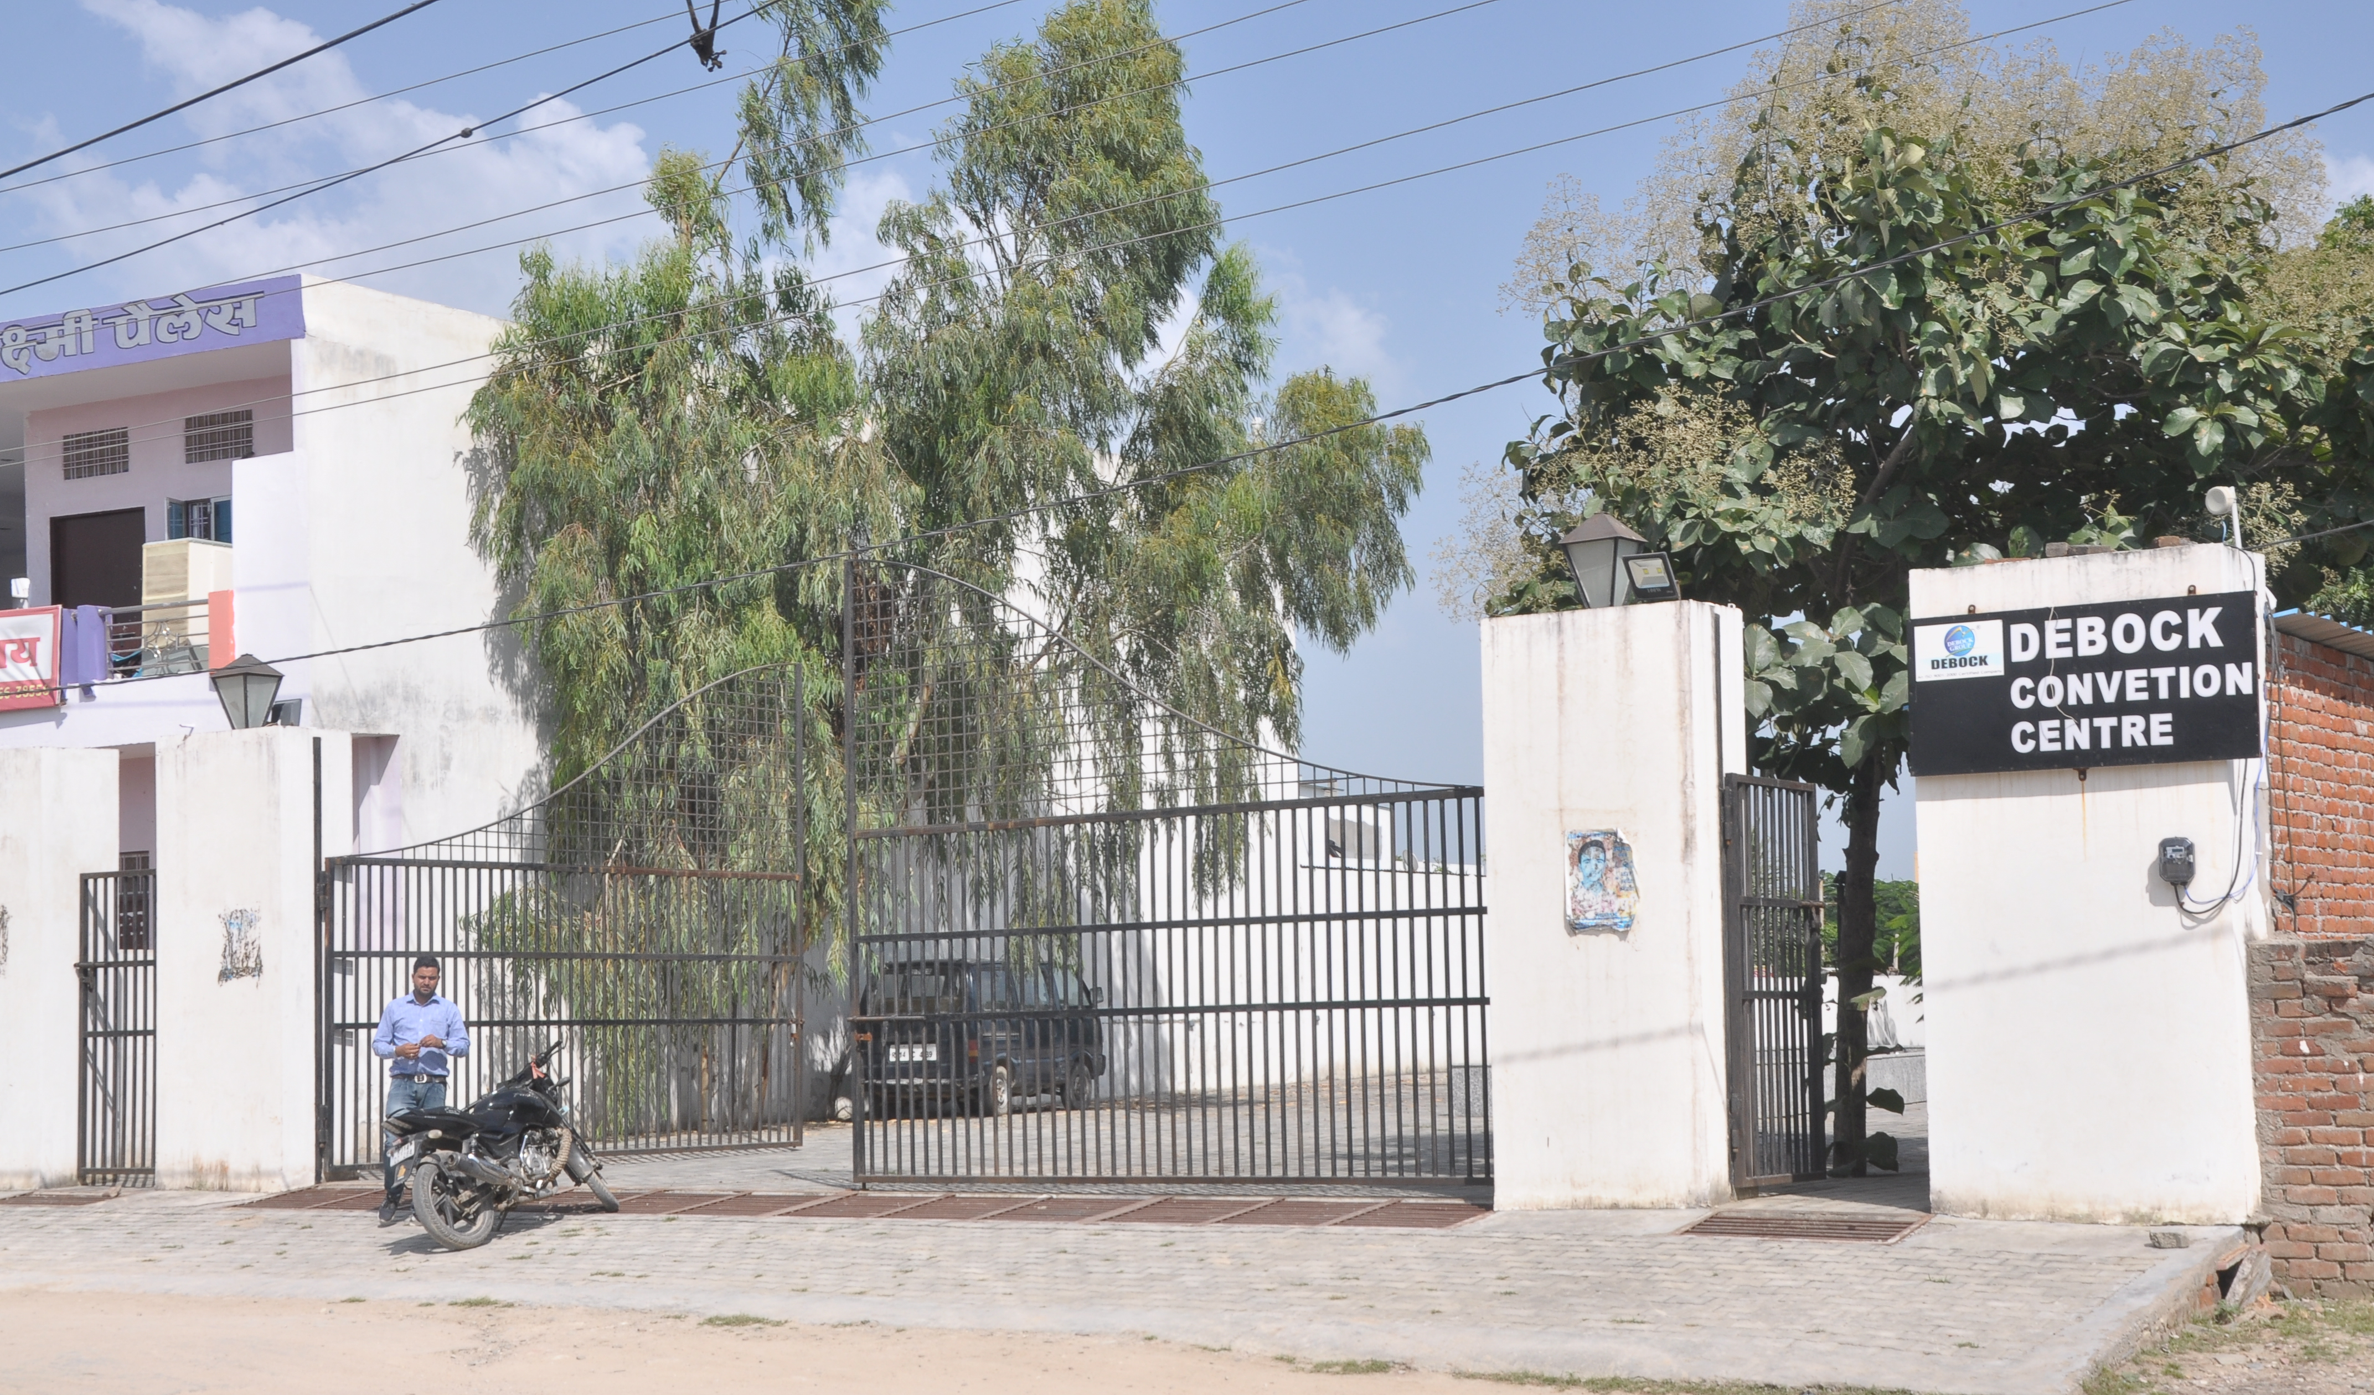

Slide 10
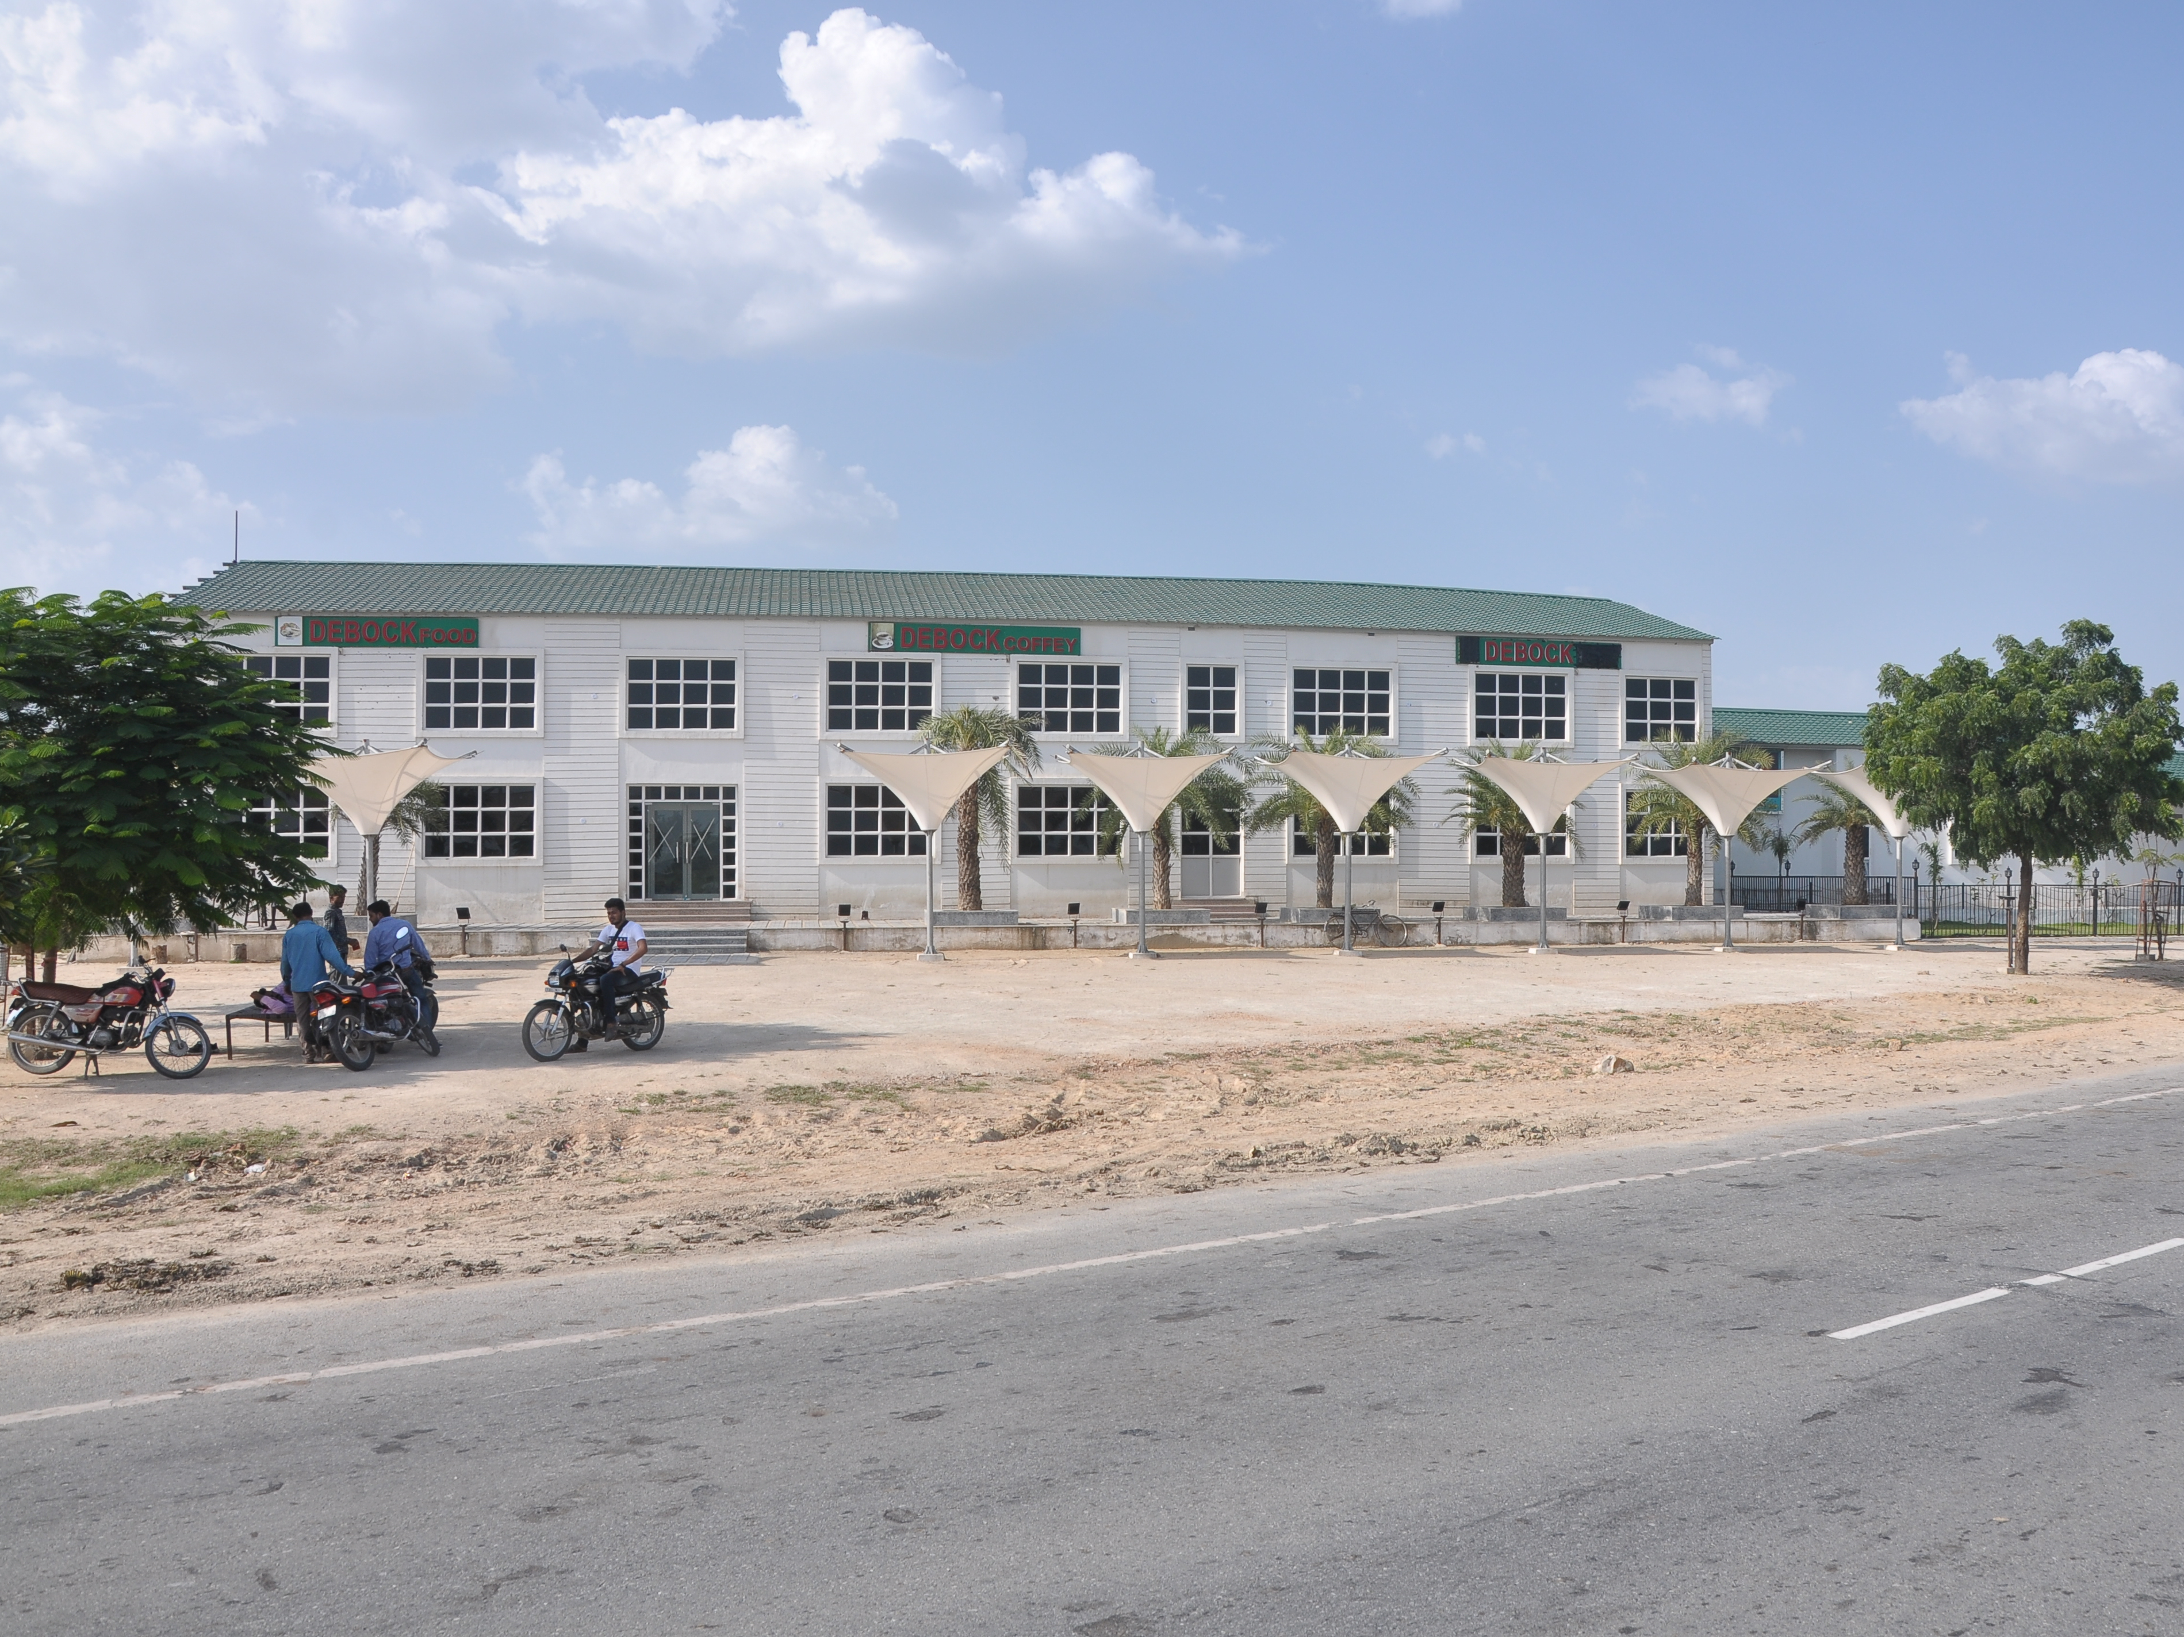
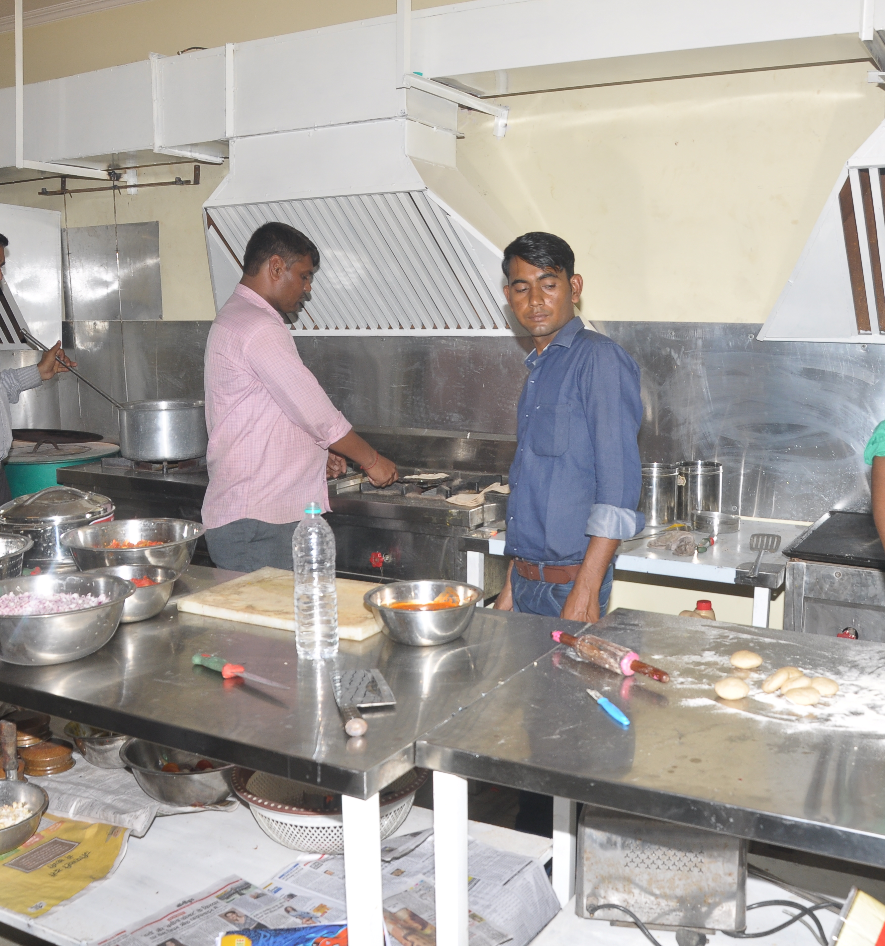

Slide 11
Agriculture Equipment Manufacturing
Agriculture the highest contributor to the GDP of INDIA is shifting from traditional to the modern and technical farming. Debock is contributing a big part in this industry through there agriculture equipment manufacturing units.
We have plans to come up with Manufacturing plants in all 7 divisional headquarters of Rajasthan, and to develop a strong distribution network with the help of C& F and dealers at every district level.
Since we have successful journey in the field of Agriculture equipment’s, Now one step ahead we have started an R& D lab where experts are working on the grounds of identifying and designing special equipment's which will help farmers to shift towards Natural farming, which will save the earth from chemicals used in fertilizers and pesticides, this move will finally result in good health of masses and less numbers of diseases.
As we spoke about natural farming, we will start tie-ups with NGO’s a and self-help groups to educate farmers in natural farming and to create an eco-system with help of applications where farmers will get all support right from training, equipment's, finance, buyers and cold storages.

Slide 12
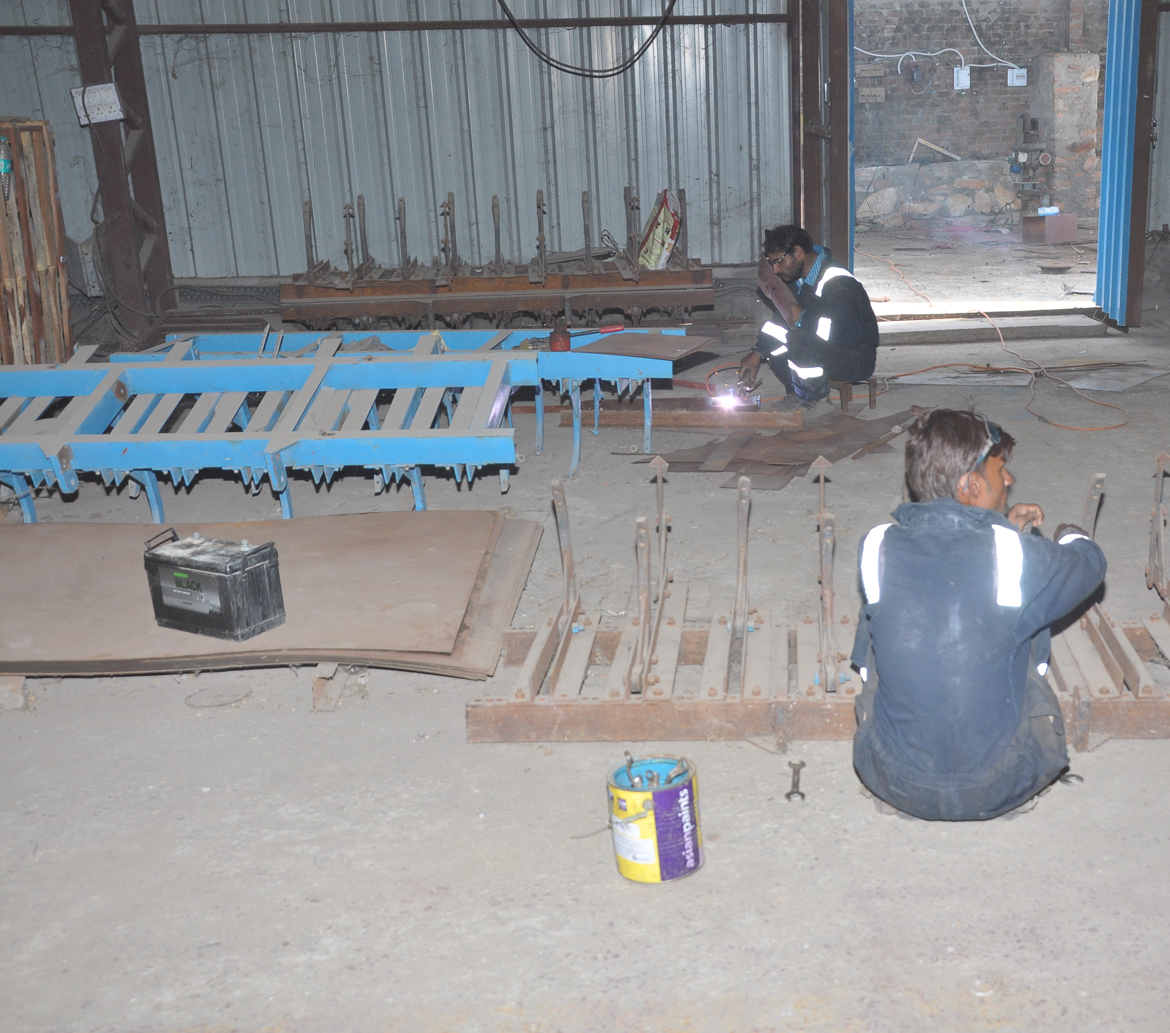
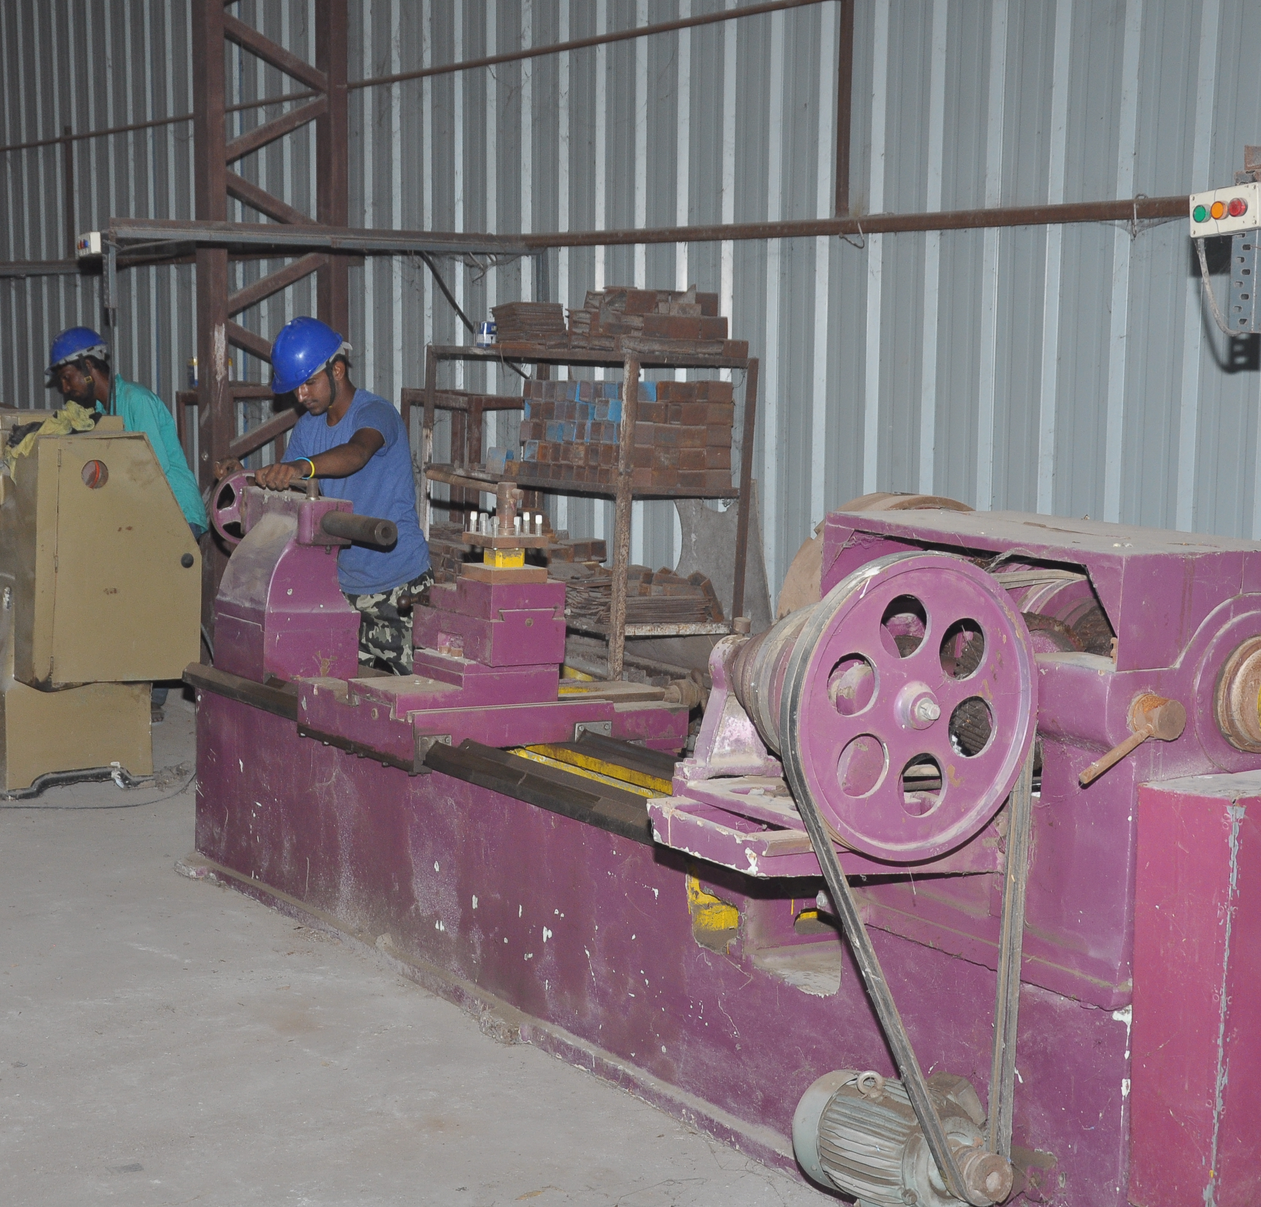

Slide 13
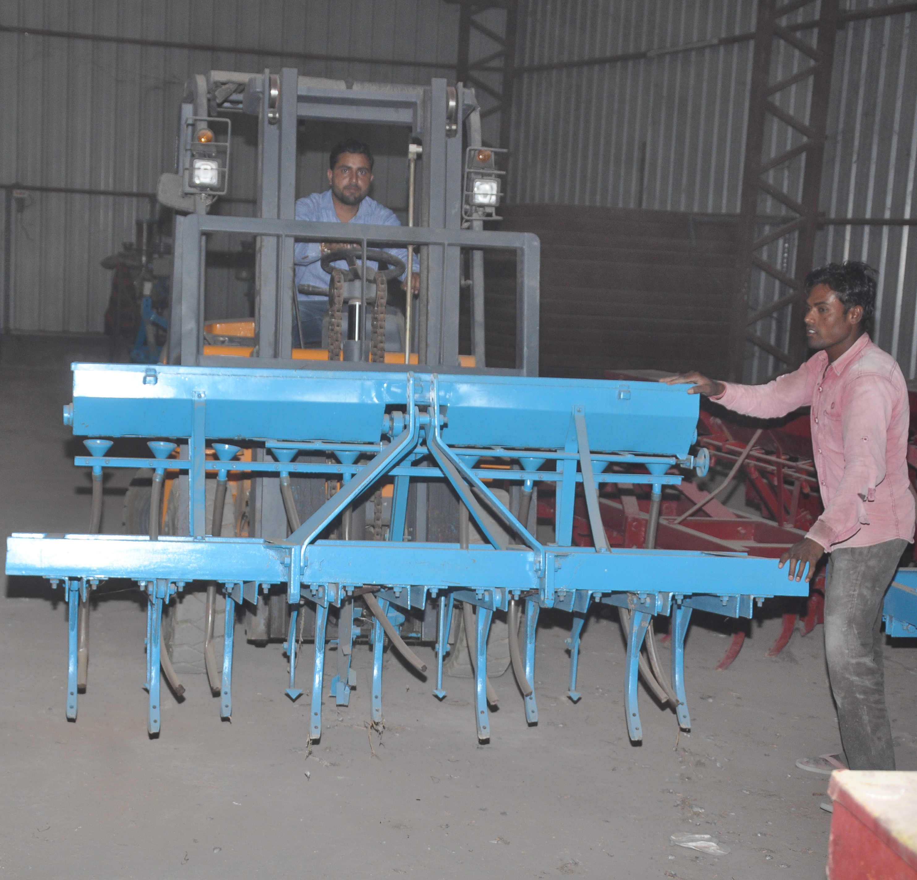
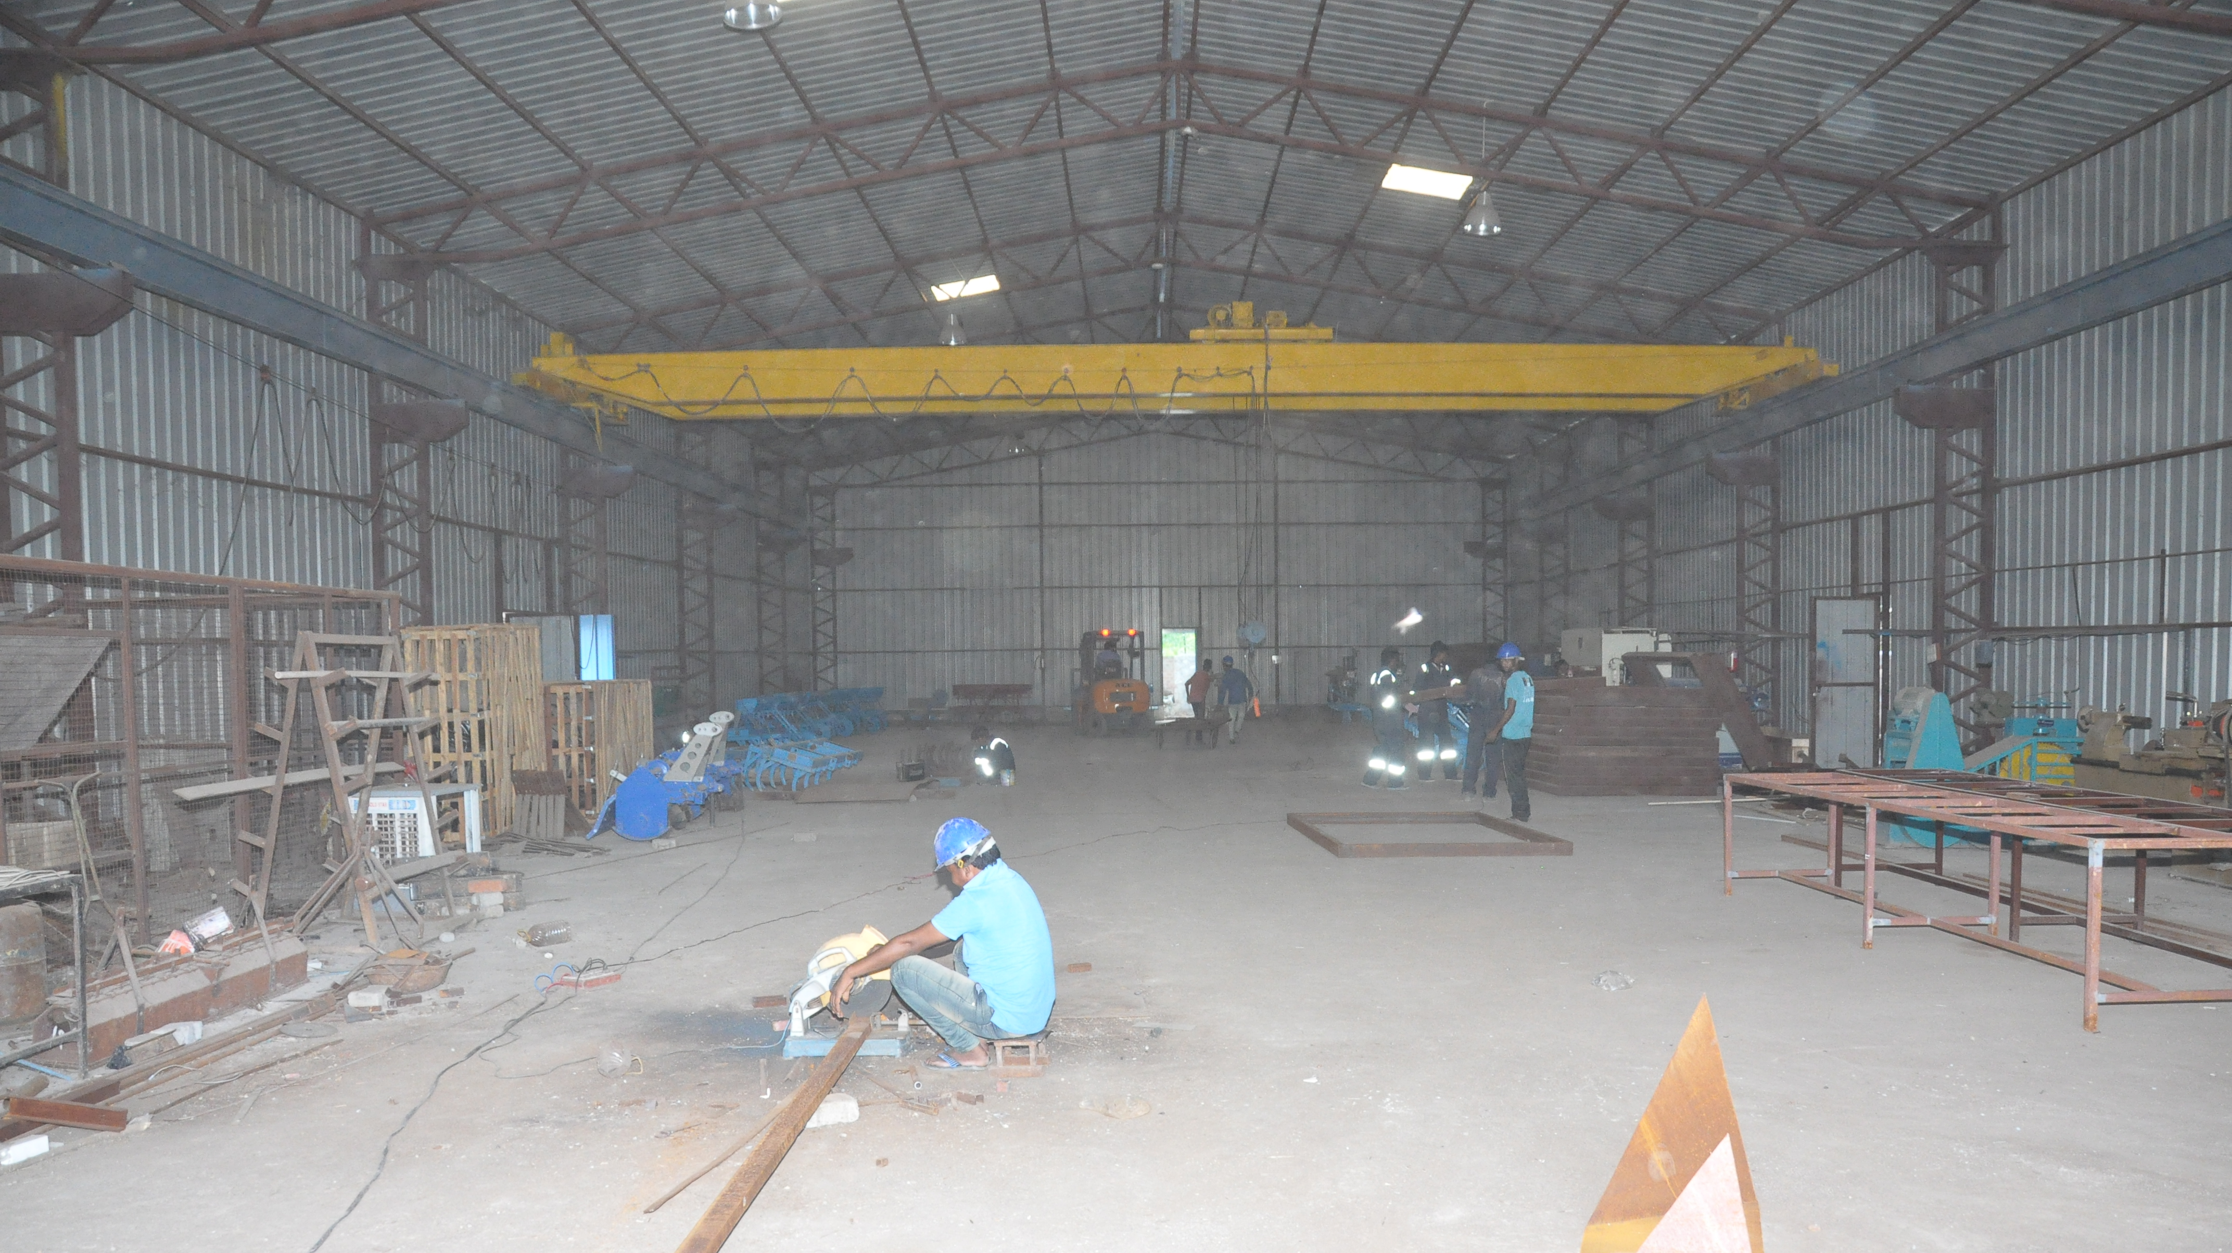

Slide 14
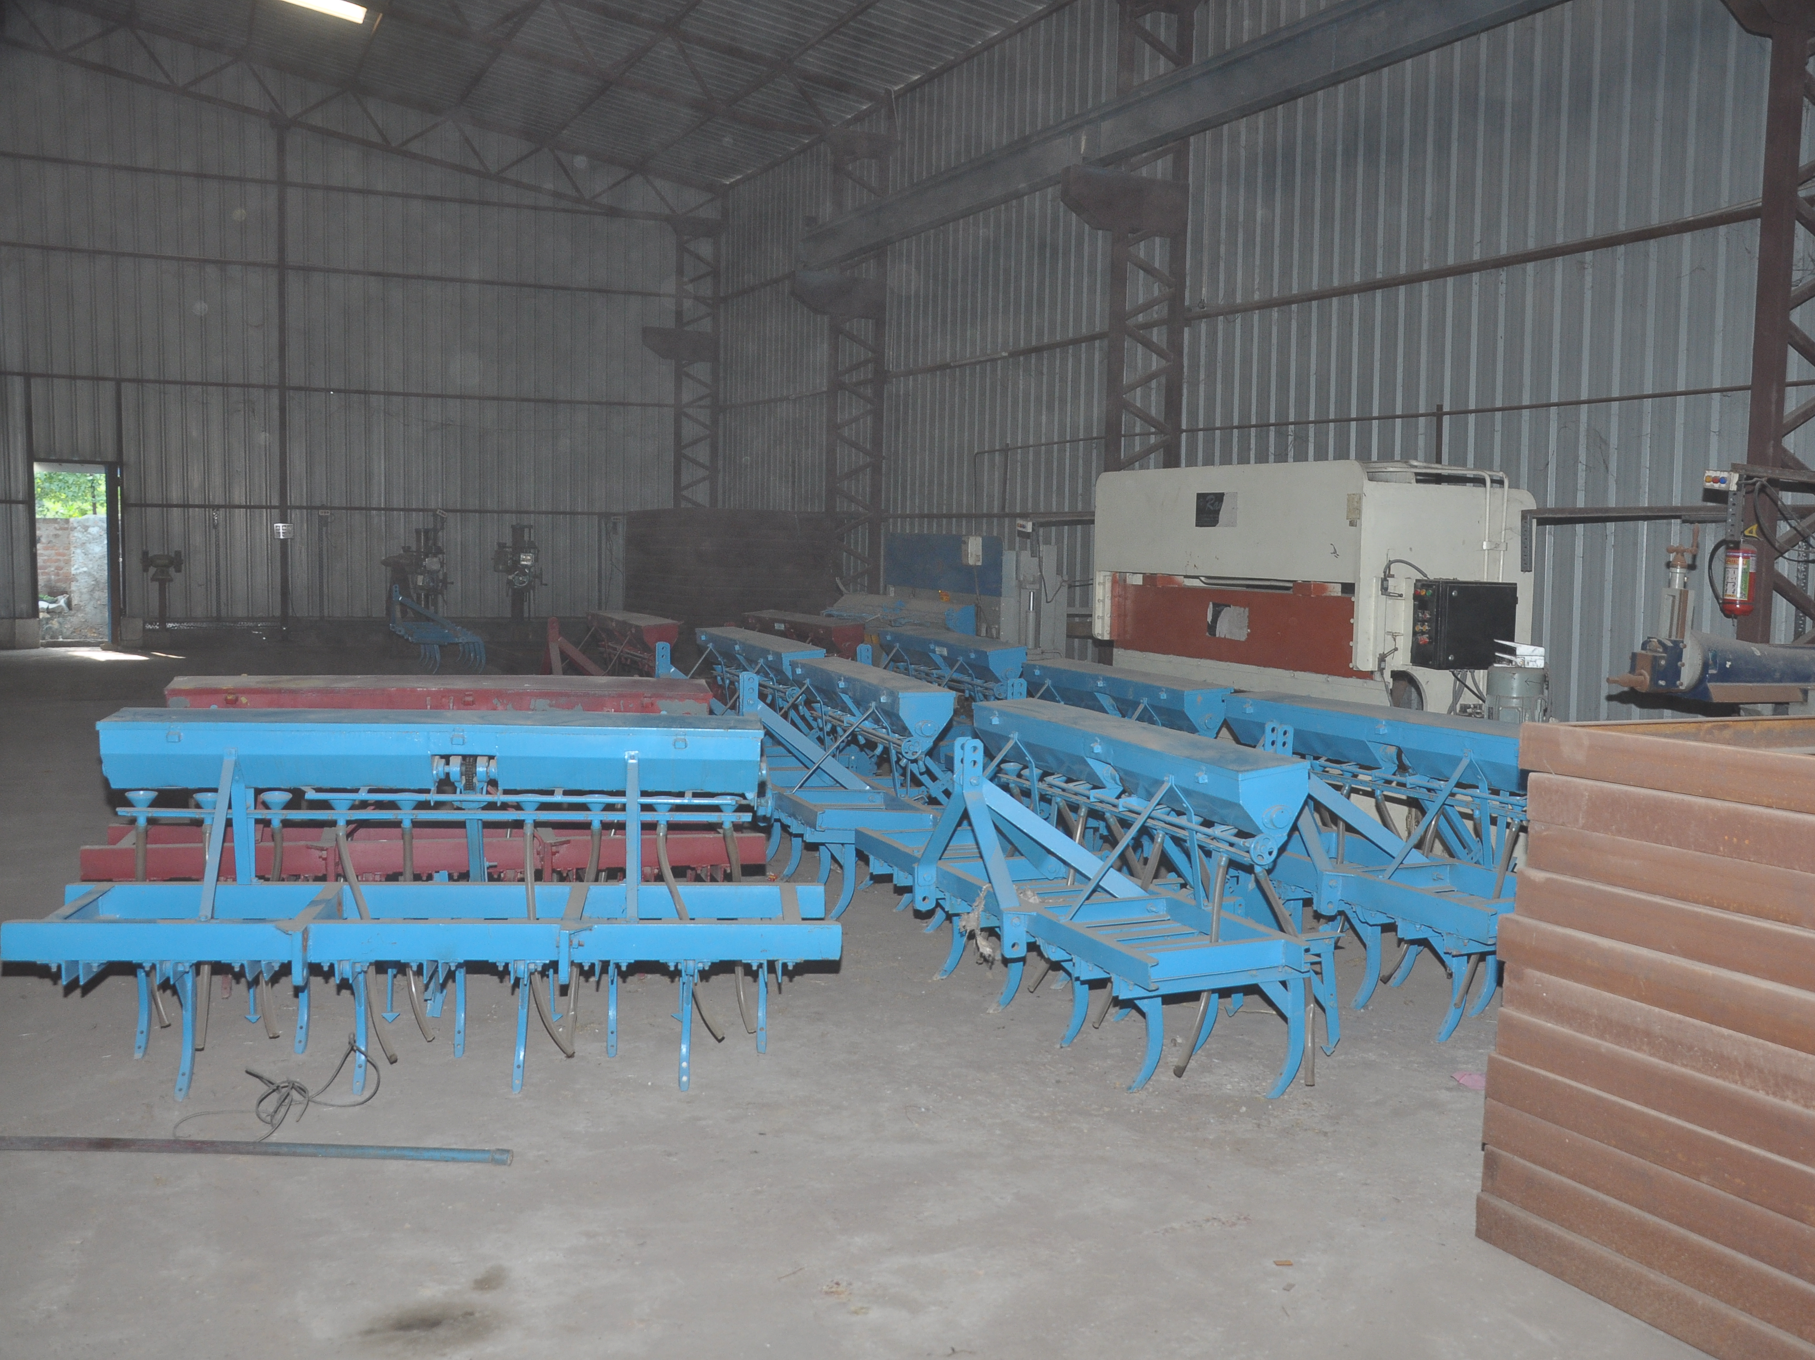
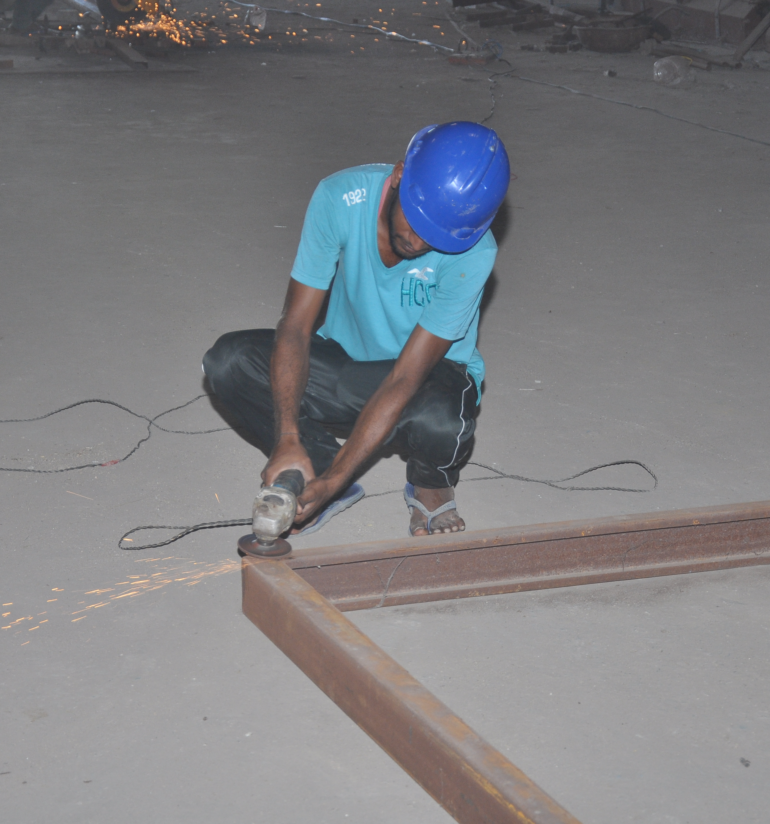

Slide 15
Mining
We are getting in new and very exciting vertical of business, that is mining. We have already stared our journey in this direction with our first mines in Udaipur in ___ acres of land. Where we are extracting Marble.

Slide 16
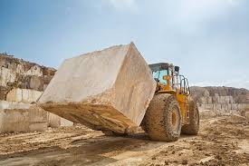
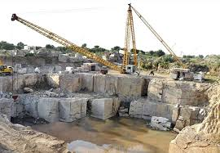

Slide 17
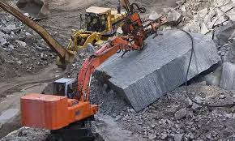
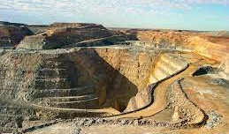

Slide 18
Sales and Marketing
Every business needs a strong Marketing and Sales team, with an experience of more than a decade in this field Debock where a bunch of experienced Sales professionals are working day-in and out will going to start supporting manufacturing businesses to increase their revenue numbers.
Debock will aquire equity in the business having a strong business model and with the help of existing team will generate additional revenue for the aquired businesses which will finally result into the additional top line and bottom lines for debock and lucrative returns for the investors.

Slide 19
Our numbers speak for us

Slide 20
Particulars | 2014-15 | 2015-16 | 2016-17 | 2017-18 | 2018-19 | 2019-20 | 2020-21
Revenue | 405 | 1016 | 1607 | 1758 | 2041 | 1870 | 3077
EBIDTA | 33 | 86 | 74 | 172 | 189 | 166 | 426
Surplus | 4 | 11 | 63 | 1255 | 1432 | 1519 | 1735
Percentage increase | NA | 160% | ( 13 )% | 132% | 9.88% | (12.1 ) % | 156%

Slide 21
Market Cap

Slide 22
What experts talk about us

Slide 23
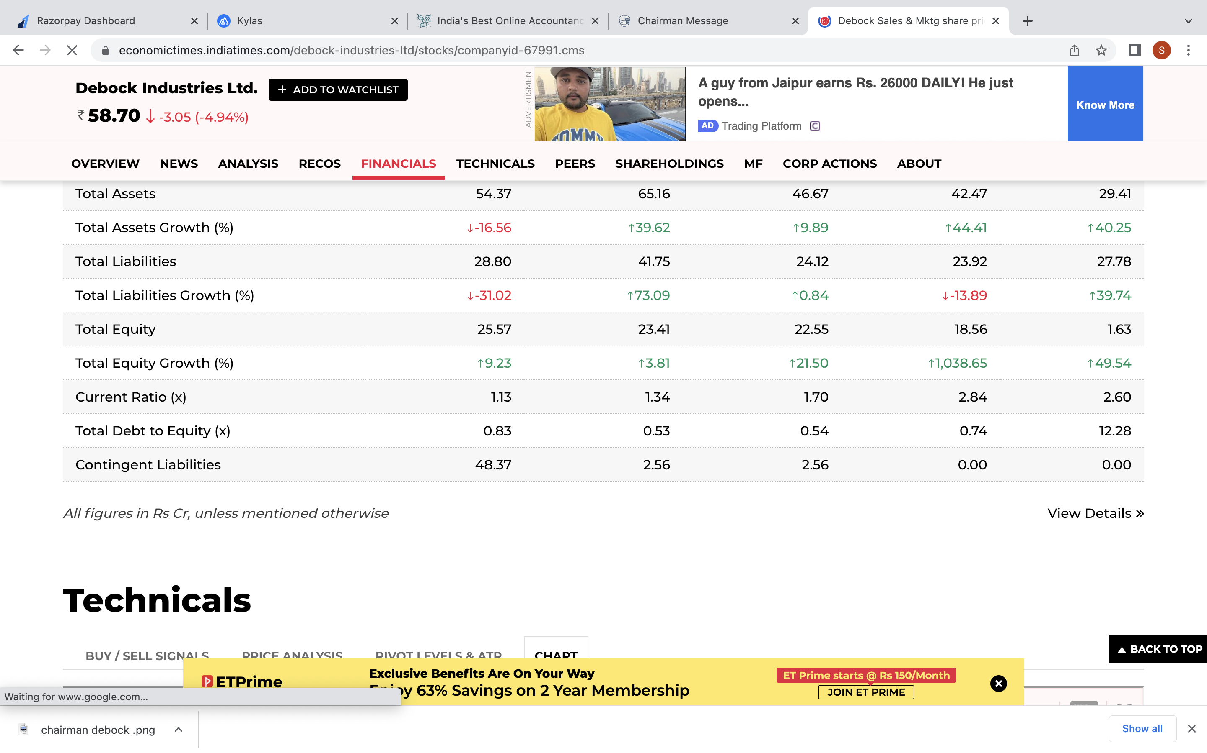
Economic Times

Slide 24
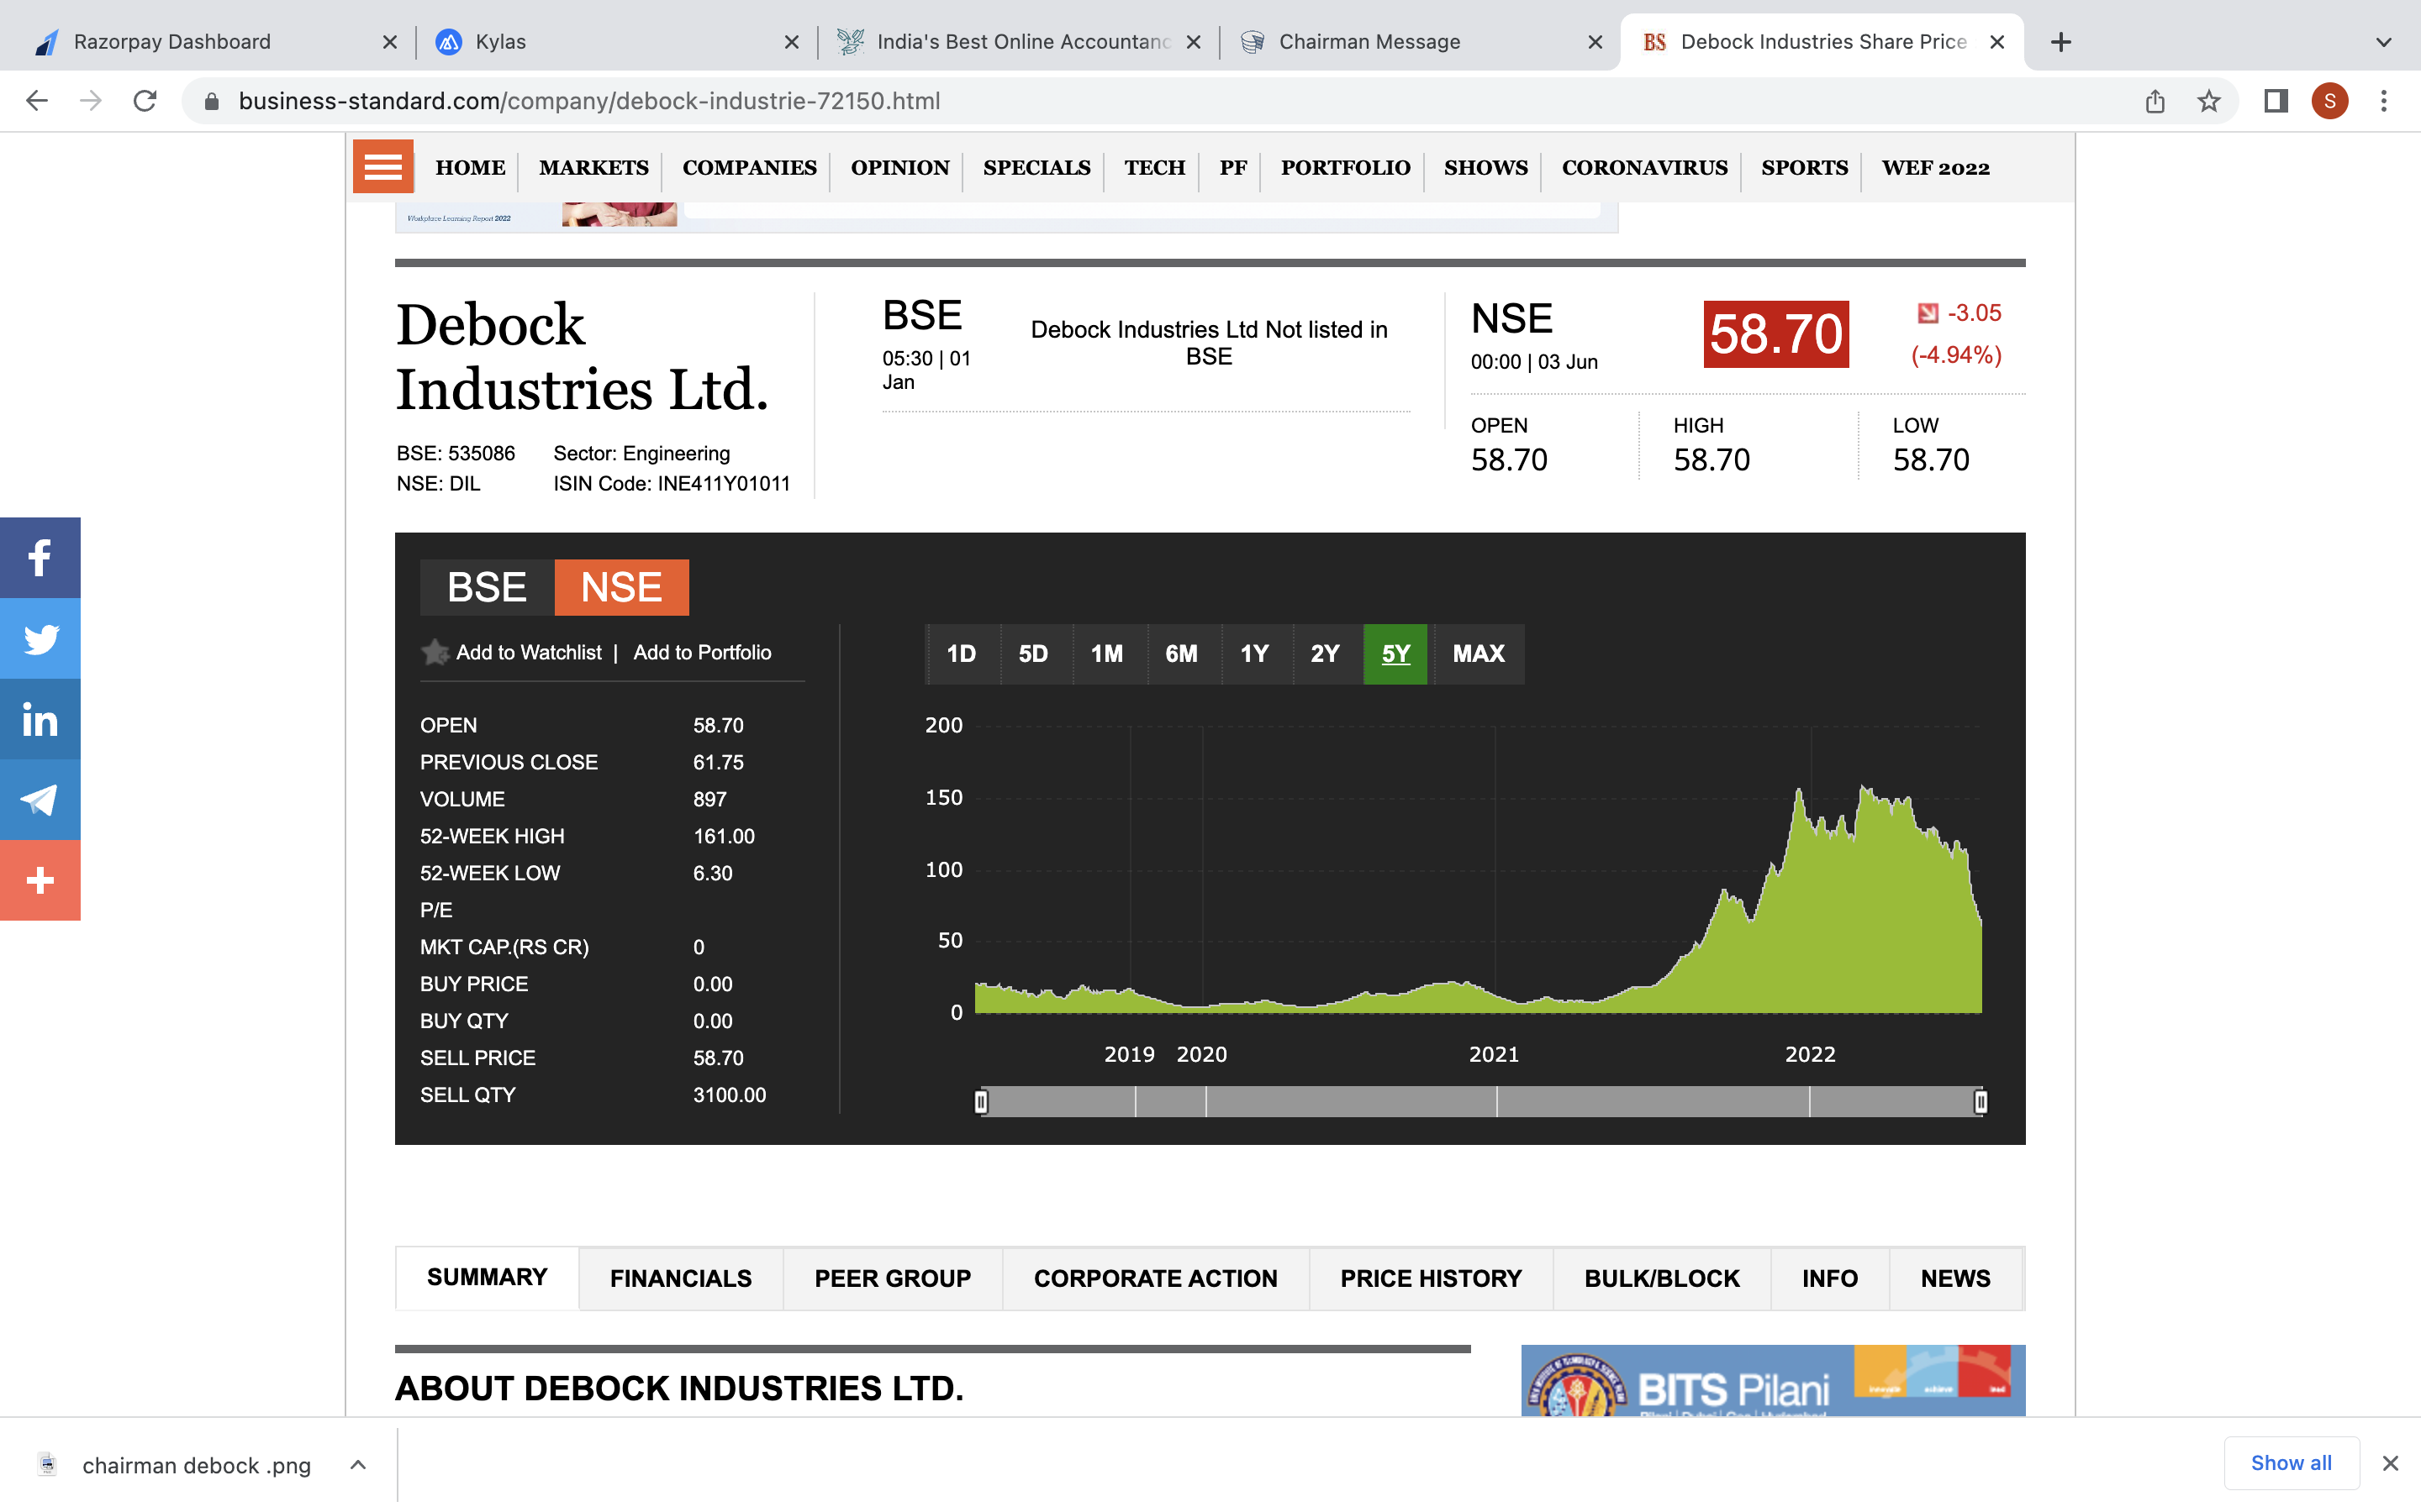
Business Standards

Slide 25
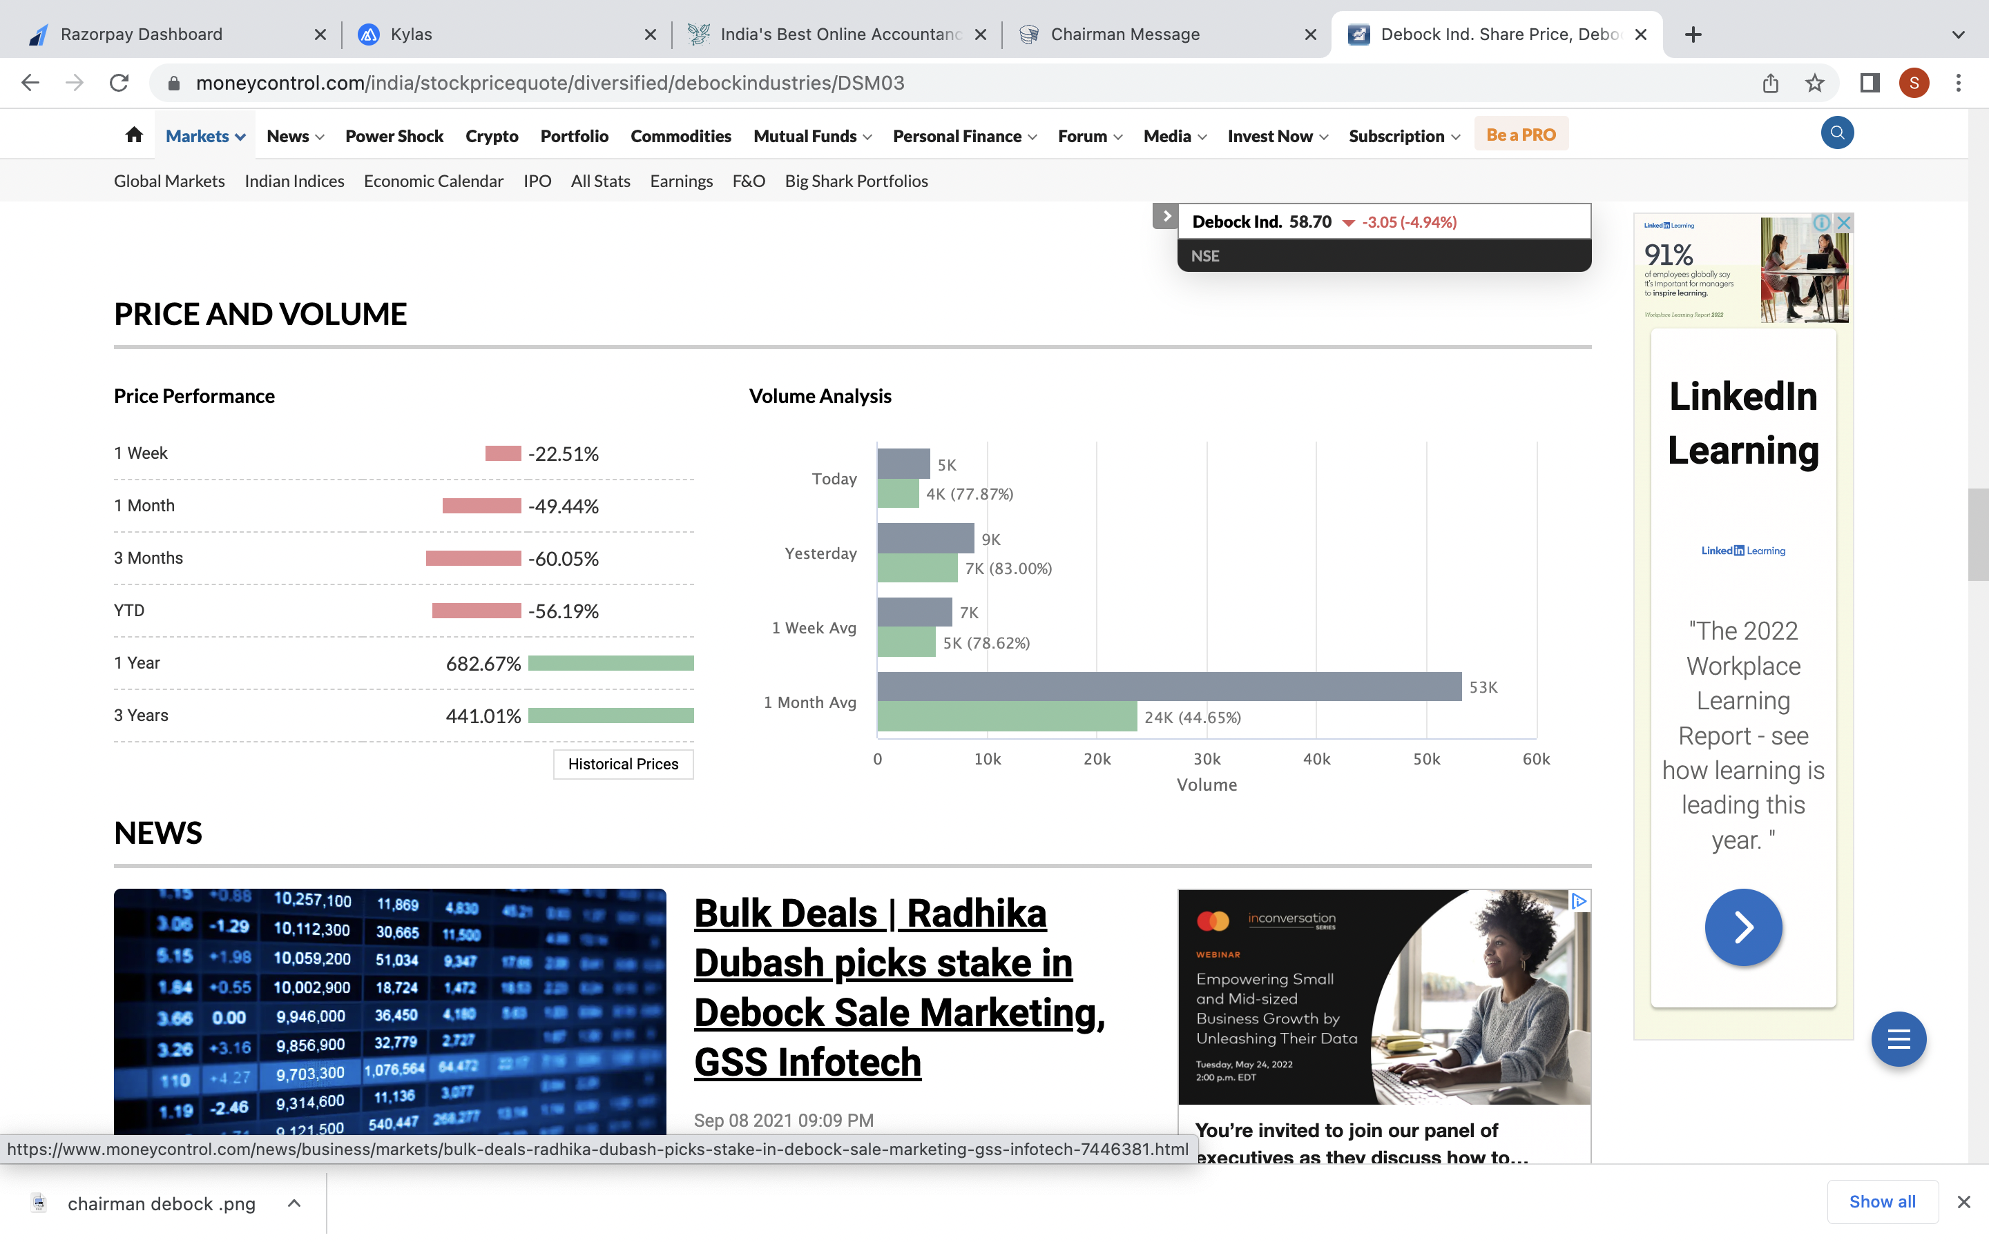
Money Control

Slide 26
Thank you
Contact Details:

